Slide 1
Hill Cipher
Dr.N.Gopika Rani,
Assistant Professor (SG),
Department of CSE

Slide 2
Introduction
Hill cipher is a polygraphic substitution cipher based on linear algebra.
Each letter is represented by a number modulo 26. Often the simple scheme A = 0, B = 1, …, Z = 25 is used, but this is not an essential feature of the cipher.
To encrypt a message, each block of n letters (considered as an n-component vector) is multiplied by an invertible n × n matrix, against modulus 26.
To decrypt the message, each block is multiplied by the inverse of the matrix used for encryption.

Slide 3
Example
Input :
Plaintext: ACT
Key: GYBNQKURP

Slide 4
Encryption
We have to encrypt the message ‘ACT’ (n=3).
The key is ‘GYBNQKURP’ which can be written as the nxn matrix:
6 24 1 0
Key : 13 16 10 ACT 2
20 17 15 19

Slide 5
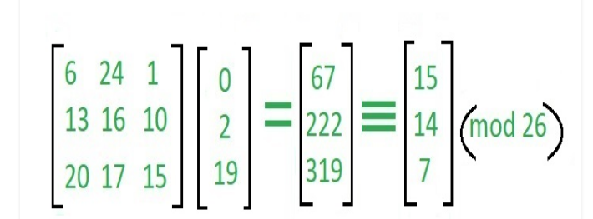
Encryption
which corresponds to ciphertext of ‘POH’

Slide 6
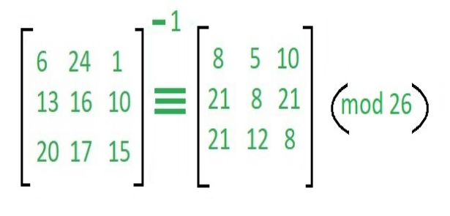
Decryption
To decrypt the message, the ciphertext is turned back into a vector, then simply multiply by the inverse matrix of the key matrix

Slide 7
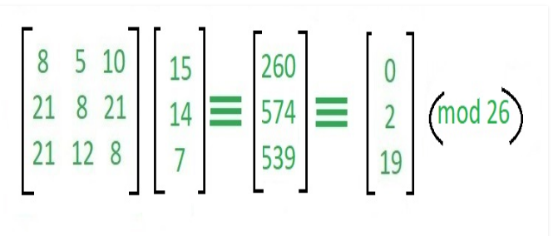
which gives us back ‘ACT’.

Slide 8
Thank You

